Slide 1
F3: An FPGA-Based Transformer Fine-Tuning Accelerator With Flexible Floating Point Format
Zerong He, Xi Jin, Zhongguang Xu
Presented by: Samarth Sharma

Slide 2
Abstract
They propose F3, an FPGA accelerator for fine-tuning Transformers.
They use a flexible floating point (FFP) format to save resources and computation.
They also adapt LoRA (low rank adaptation) to FFP -> LR-FFP ->reduces no of training parameters without compromising on training.
They have also redesigned the FPGA datapath by using specialized processing elements (PEs). One DSP slice now does two MACs per cycle. PEs are arranged for efficient matrix multiplication.
Board used- Xilinx VCU128
Performance of 8.2e12 floating point operations/sec (TFlops) at 250MHz.
15.22x speedup with CPU and 3.44x speedup with GPU
Energy efficiency: 70.52x, 9.44x

Slide 3
Introduction
Transformers have revolutionized AI, but building them from scratch is not feasible. So, fine-tuning pre-trained models for specific tasks is more practical.
This requires personal data, which due to privacy reasons can only be used on edge devices -> But, it leads to significant resource and power constraints
FPGAs- flexible dataflow and high energy efficiency.
So far FPGAs have been primarily used for inference, not fine-tuning.
Floating points are useful to maintain accuracy. But FPGA performance with floats for fine-tuning is computationally expensive.
They use 2 approaches to fix this- Algo level(LoRA), HW level(FFP)
Current FFP approaches (BF16, FP8) have high resource cost due to exponent alignment computation, so PE becomes bulky.

Slide 4
To fix this, a BFP (block floating point) format is proposed. It aligns the exponents and rescaling the mantissa.
It saves memory and simplifies hardware. But, it fails for training due to transpose operation.
Solution- their new FFP based design which also works for training.
LoRA+FFP -> LR-FFP (FPGA friendly)
Softmax and low-rank matrix multiplication (LRMM) are accuracy sensitive but they have low time complexity. So BF16 can be used.
Bottleneck- GEMM (General matrix multiplication). Using FFP for GEMM, we can do more MAC operations and reduce resources.
Impact: FFP boosts computing power by 8x and LoRA reduces the number of trainable parameters by two orders of magnitude.
Based on FFPs, a resource efficient PE is designed and organized into systolic arrays (SA) to perform GEMM.

Slide 5
The low rank matrices after LoRA makes SA very insufficient.
Solution: LR-SA (Small array, high precision/flexibility. Optimized for low-rank matrices), GEMM-SA (Large array, lower precision/flexibility. Optimized for large GEMM)
F3: an FPGA-based transformer fine-tuning accelerator using LR-SA and GEMM-SA

Slide 6
Background and Previous Work

Slide 7





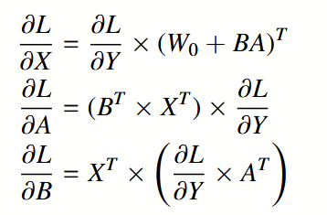
Fine-Tuning Transformers with LoRA
Doesn’t change model structure or inference cost unlike previous implementations. Instead, it modifies weight updates using low rank decomposition.
Suppose, pre trained matrix is . Instead of updating weights in Wo directly, LoRA represents the update as: r<<d,k. Wo is frozen during training, only A,B are updated
Forward pass:
Backward pass: we need gradients, error. Since Wo is frozen, only gradients of A,B need to be computed -> saves computation.
Weight update: AdamW optimizer updates A,B (both very small matrices, so minimal overhead.

Slide 8


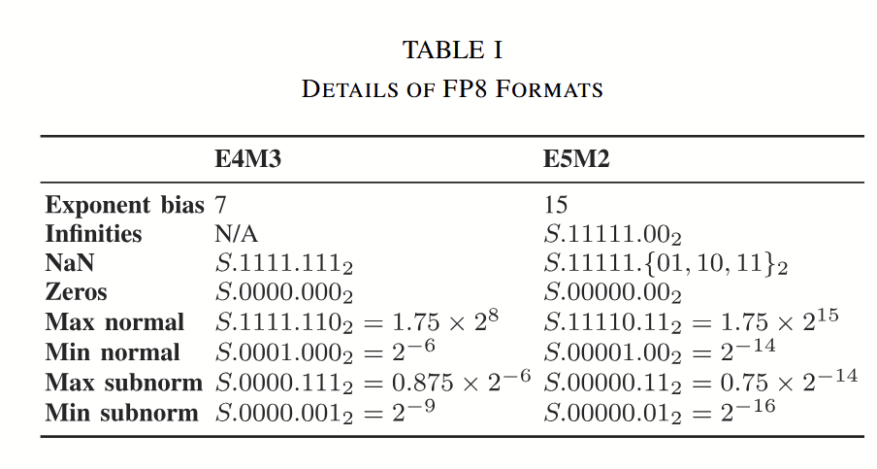
8-bit floating point
Float = s-sign, f-mantissa, e-exponent, b-bias
We- exponent width.
E4M3- 4 exp, 3 mantissa (better prec, small range)
E5M2- 5 exp, 2 mantissa (better range, lower prec)

Slide 9
FPGA based MAC
MAC is implemented in DSPs in FPGAs. Xilinx came up with a way to do two smaller (signed 8 bit) MAC operations using one big DSP slice in one clock signal.
Say a DSP can multiply two 27 bits nos. Pack 2 8 bits nos (a,b) with space in between and send to MAC. When multiplied by another 8 bit no (c) , both calcs can be done at the same time.
Limitation- space between them is limited, so while accumulating, overflow may happen.

Slide 10
Hardware Accelerators for Transformers
Most FPGA based transformers focus on inference.
Main bottleneck for LLM isn’t raw compute power but limited memory bandwidth.
On-device training is very challenging.
Multiple approaches exist but they either focus on solely on inference or do not have efficient hardware due to irregular memory access patterns and unbalanced workloads.
Yu et. al. explored the closest approach (LoRA to FP8) to this paper but did not evaluate the performance of the whole system. They showed FP8 matched accuracy of BF16 but resources on FPGAs are much higher as compared to INT8. So FP8 needs to be modified to match the resources of INT8.

Slide 11
FPGA-Friendly Fine-Tuning Strategy

Slide 12
Observation on 8-bit floating point fine tuning
First, a hybrid FP8 strategy was used. Weights and activation in E4M3, errors in E5M2. They fine tuned BERT-Small and DistilBERT.
Both formats were massively underutilized. Exponent bits were wasted.
As shown in Figure 1, the average utilization of exponent bits for weights and errors is quite low, at 39.4% ∼ 41.6% and 19.4% ∼ 29.3%, respectively
Standard FP8 is too wasteful, hence a custom FFP needed to be developed.

Slide 13
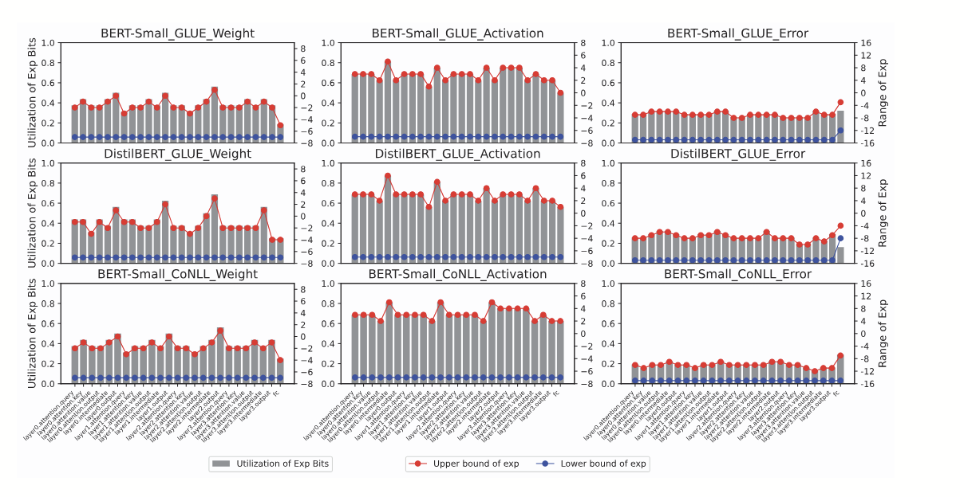

Slide 14

Details of custom FFP format
They divide a large input matrix into smaller vector blocks. The range of numbers within one of these small blocks is much smaller and more predictable than the range across the entire matrix.
For each block, they calculate and assign a custom exponent bias based on the maximum value within that specific block.
This slides the format's range to perfectly match the data's range in each block, eliminating waste and maximizing precision.
For efficient FPGA design, the final fixed point operand after all exponent alignment was done was restricted to 9 bits.
A 9-bit operand limits the mantissa shift to 8 bits maximum. An 8-bit shift limit forces the exponent width to be no more than 3 bits.
Final format: FFP-E3M4

Slide 15
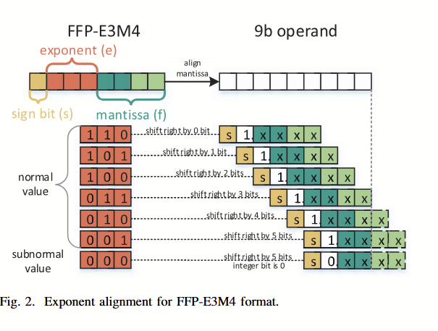

Slide 16
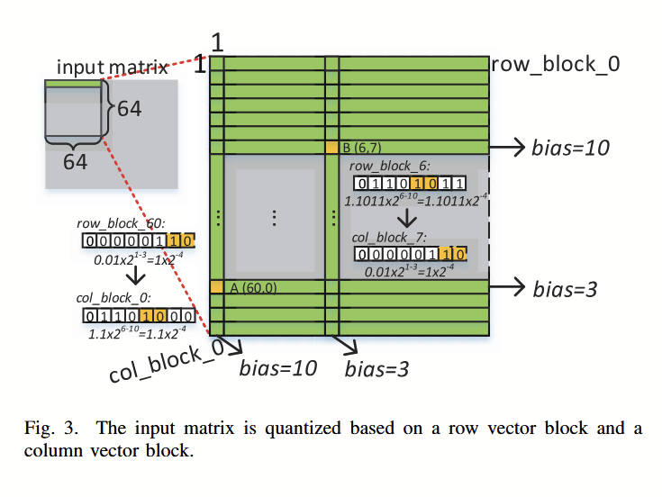
To handle transpose/matrix multiplication, a dynamic requantization scheme was used: Quantize row blocks and column blocks separately, Save exponent bias for each block type. So numbers still stay in ranges.

Slide 17
LR-FFP fine-tuning strategy
Bottleneck: GEMM - FFP8 is used here to save resources.
Operations that have low time complexity but are critical for model convergence are kept in high precision.
delL/delA, delL/delB - BF16/FP32, softmax, norm, activation - BF16, weight update - FP32 (safe convergence), activations, errors, big multiplications-FFP8
So only the GEMM path is FFP8. Rest stays in BF16/FP32 for accuracy. LoRA keeps the training workload tiny.
As a result, much lower FPGA costs than full FP8 methods, with accuracy intact!

Slide 18
Systolic Array Design - GEMM-SA, LR-SA

Slide 19
Processing Element for FFP8 format
In FFP8, inputs are already exponent aligned -> no need for alignment logic.
Xilinx DSP48E2 was used (18x27 Multiplier, 48-bit Accumulator) to pack two 9-bit signed MACs in one DSP slice.
Why 9? Fits perfectly in 27-bit input width, maxes utilization.
Packing only 2 MACs so tightly leaves only 1-bit gap between the lower and upper results of accumulator. Might lead to overflow.
Solution: lower accumulation (pl) capped at 17 bits and 2 MSBs are used to detect an overflow event. If overflow is detected, a correction value is applied and a simple counter tracks the overflow events. At the end, a Recovery Module uses the final accumulated value and overflow count to reconstruct the two correct results perfectly.

Slide 20
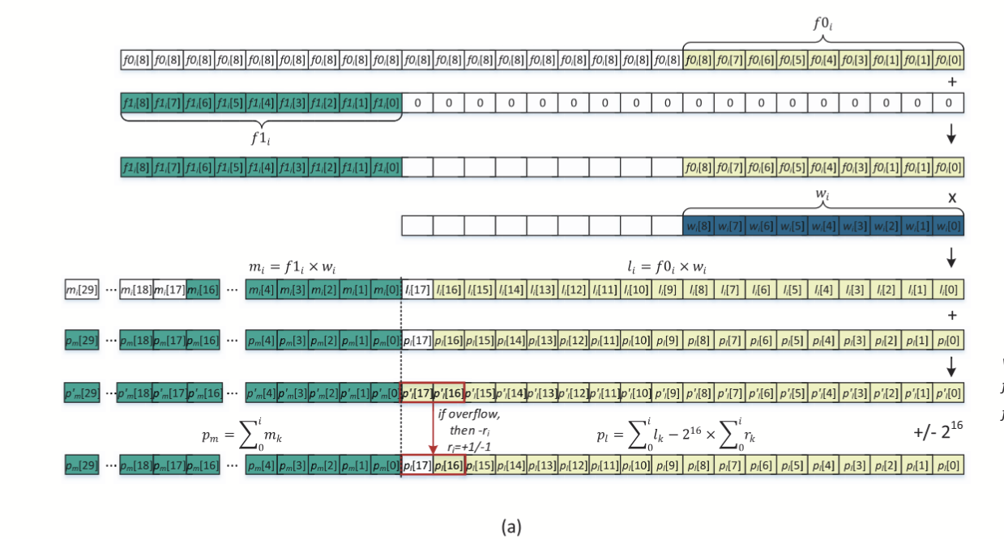

Slide 21
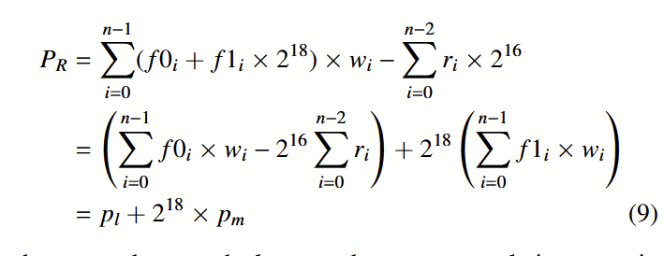
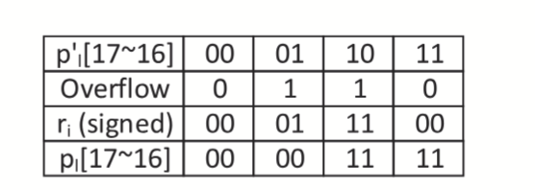
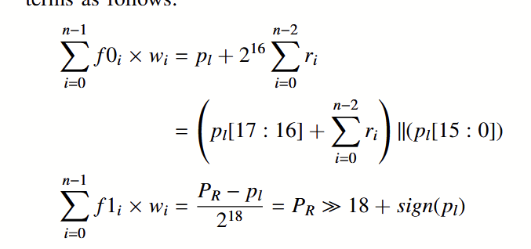

Slide 22

Design Space Exploration for GEMM-SA
They try to find the most efficient shape for their GEMM-SA.
GEMM:
Say GEMM-SA size is mxn (mn=S).
Due to double MAC, output matrix of SA is mx2n. The latency can only be minimized only when m = root(2S), n = root(2S)/2.
Most appropriate size for GEMM-SA is hence 2nxn.
3 dataflow schemes were analyzed: OS, WS, AS (activation stationary).
Analysis showed OS is rarely the best choice. So, they chose to implement WS and AS dataflows for their GEMM-SAs.

Slide 23

High Precision and Flexible LR-SA
LRMM
To handle LoRA, a separate specialized SA called LR-SA(BF16) was designed.
Performs one BF16 MAC per cycle. Any data coming in FF8 is de-quantized back to BF16 before being processed.
Optimized shape: fixed 8x64 (since LoRA rank R is typically 8)
For small, non-square matrices, the choice of dataflow has a massive impact on performance.
To avoid this, they designed the LR-SA to be flexible, i.e., it can change dataflow modes as required.
If T=R, array uses highly efficient WS dataflow. Otherwise, it switches to OS dataflow. It does increase resource consumption but it is not significant due to small size of LR-SA.

Slide 24
F3 Hardware Architecture

Slide 25
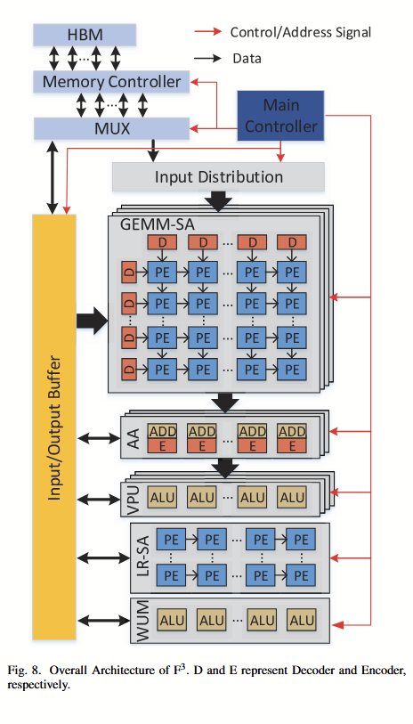
Architecture Overview
WUM- weight update module
VPU- vector processing unit
AA- adder array

Slide 26
Vector Processing Unit
Perform complex functions, such as soft-max, layer normalization, activations.
Built from ALUs, each of which is in BF16.
Each ALU has a multiplier and an adder, all don’t have a divider.
Dynamically adaptable dataflow. This avoids wasting cycles/resources.
It has low bandwidth needs due to high internal data reuse and constants.
The architecture supports the three main phases of fine-tuning: Forward Pass (FP): Compute outputs using frozen weights plus LoRA low-rank adaptation. Backward Pass (BP): Calculate gradients on only the low-rank parameters, using both GEMM-SA and LR-SA efficiently. Weight Update (WU): Perform low-cost updates on trainable LoRA parameters separately.

Slide 27
Dataflow optimization for fine-tuning
LR-FFP reduces training params but introduces extra operators like LRMM.
This makes the dataflow complex which needs to be optimized.
Optimization 1: Data Reuse - The results of one layer are cached on-chip to be used as inputs for the next layer. Weight matrices are also reused.
Optimization 2: Overlap BP (backward pass) and WU: LR-SA computes gradients, WUM immediately updates weights.
BP is the bottleneck due to heavier workload in LR-SA.
Solution: Shift a part of computation from BP to FP. This does not slow FP since in that phase, GEMM-SA is the bottleneck and not LR-SA.

Slide 28
Evaluation Results

Slide 29
Experimental Setup
Models: BERT-Small (29M params), DistilBERT (68M params)
Datasets: GLUE(classification), CoNLL (NER), SQuAD (QA)
Hardware: F3 on Xilinx VCU128 FPGA
Baselines: CPU (i9, FP32), GPU (V100 FP32, 2080Ti FP16)

Slide 30
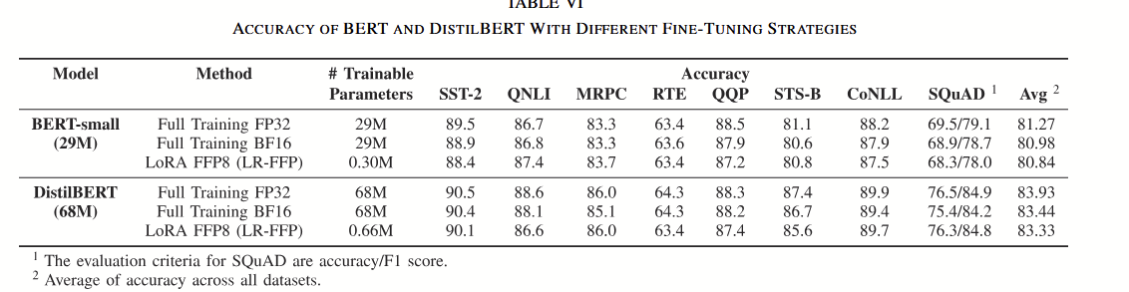
Accuracy
LR-FFP reduces training params to 1%. Accuracy drop <= 0.6% on average. DistilBERT suffers slightly more. Accuracy can be tuned by changing LoRA rank.

Slide 31
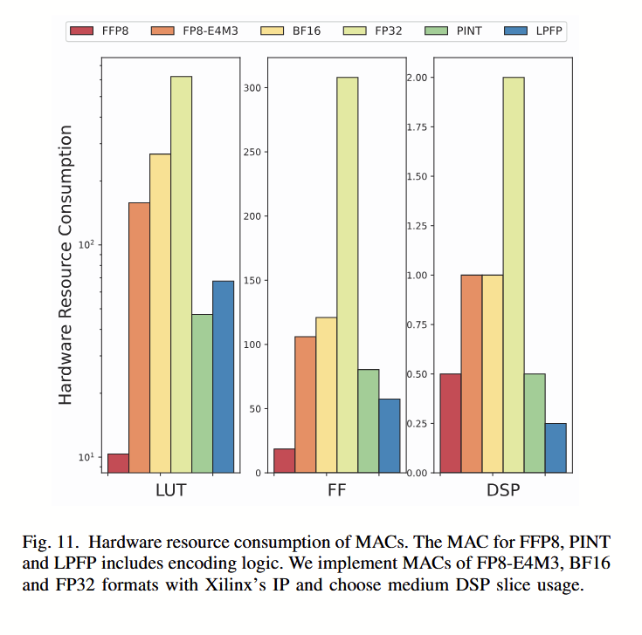
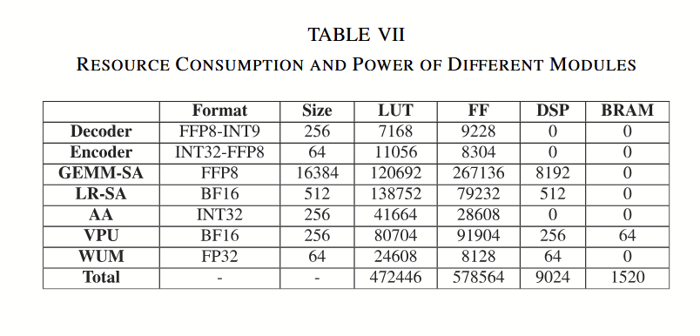
Hardware Resource Evaluation
Biggest consumers: GEMM-SA, LR-SA, VPU. LR-SA is small but costly (BF16 PEs + OS support). FFP8 MACs: 15.3× fewer LUTs vs FP8-E4M3 and 8× DSP efficiency boost vs FP32

Slide 32
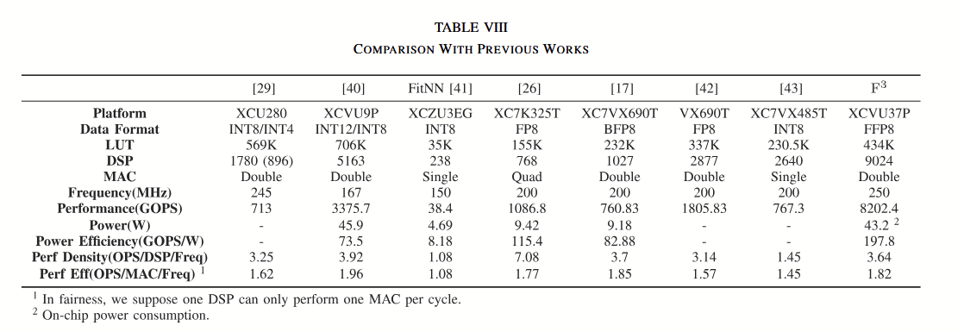
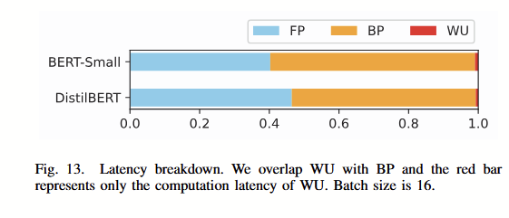
Performance and Energy utilization

Slide 33
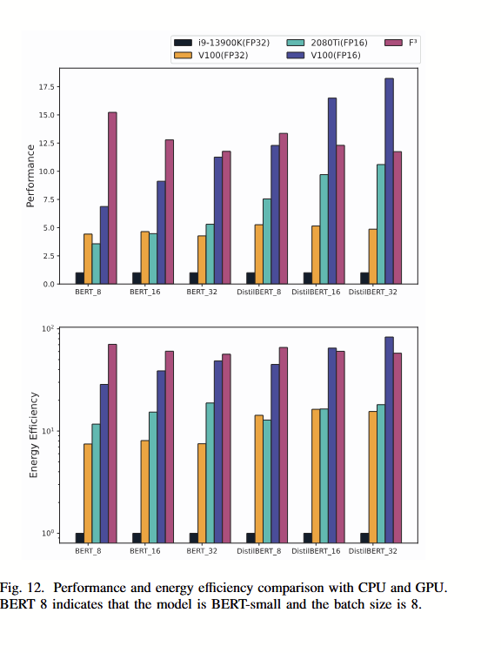
F3 vs CPU/GPU: 11.7–15.2× faster than CPU (FP32) 2.4–3.4× faster than V100 (FP32) 1.1–4.2× faster than 2080Ti (FP16) Up to 70× better energy efficiency vs CPU
Reasons: FFP8 MAC = 0.5 DSP vs FP32 MAC = 4 DSPs LoRA cuts gradient + update overhead
BP is 1.2–1.5× FP latency (not 2× thanks to LR-FFP). WU latency negligible (overlapped with BP). As models get bigger → gap FP vs BP shrinks

Slide 34
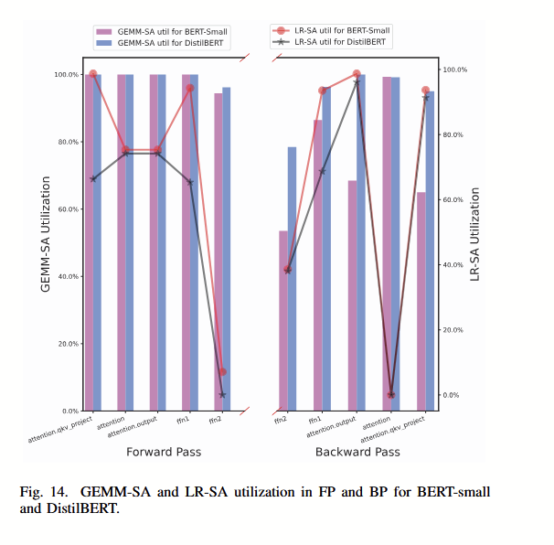
PE utilization
In FP: GEMM-SA hits peak perf
In BP: LR-SA bottleneck lowers GEMM-SA utilization
Larger models (e.g., DistilBERT): GEMM-SA dominates, LR-SA less bottleneck

Slide 35
Thank you!!

